Slide 1
Group 1 Project
Tanzim Amin
Suyin
Judat
Akin
Masooma

Slide 2

Introducing the team
ML model- Suyin
Database- Judat
Visualisation/Dashboard- Akin, Tanzim
Presentation- Tanzim, Masooma
Github- Masooma

Slide 3
Our Topic
In recent years the number of streaming sites have been increasing and with that we have access to an enormous amount of user data.
We know a users watch history, movie ratings and what other similar movies or genres they like.
Using this dataset we want to predict user preferences and how to market certain products based on their interests.
Our ML model will be providing recommendations based on Disney franchises. But can be used with other streaming datasets as well.

Slide 4
Why we selected this topic
We can use our project in a variety of business scenarios:-
Product Placement in stores
Useful to companies like ToysRus, assume users who like Lion King also likes Toy story. Then placing Lion King merchandise beside Toy Story merchandise will result in increased sales.
Since both movies fall under Adventure genre, we can suggest ToysRus to include adventure themed merchandise (adventure board games, action figures) and not just dolls.

Slide 5
Product placement flowchart
Gather User Data
Extract useful data
Predict user behaviour
Recommend
Gather user data from Disney
Clean up data
ML model
Recommend
User watch history
Movie ratings
Similar genres or movies they like
Using Python and SQL
Performing EDA
Clustering
Help companies with product placement

Slide 6
ML flowchart
Gather User Data
Extract useful data
Predict user behaviour
Recommend
Gather user data from Disney
Clean up data
ML model
Recommend
User watch history
Movie ratings
Similar genres or movies they like
Using Python and SQL
Performing EDA
Clustering
Help companies with product placement

Slide 7
Why we selected this topic
Customer segmentation
If we can segment our customers into like minded groups. We can market more efficiently and target the right customers.
Assuming a customer loves the adventure genre, we can advertise more adventure themed merchandise or movies to them.

Slide 8
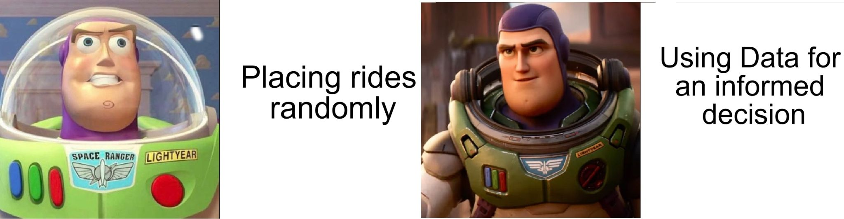
Why we selected this topic
Disney Park revenue
We can use our dataset to make informed decisions about the disney park rides.
We can put Lion King & Toy Story themed rides beside each other.
In addition, as the movie genre was adventure. The rides can be designed to be more thrilling instead of easy going, as they will appeal more to an adventurous demographic.

Slide 9
Data sources we used
Our main dataset containing five CSV files, they have data ranging from 1937 to 2016
Disney_movies_total_gross.csv
Disney_revenue.csv
Disney-characters.csv
Disney-directors.csv
Disney-voice-actors.csv
https://www.kaggle.com/datasets/maricinnamon/walt-disney-character-dataset

Slide 10
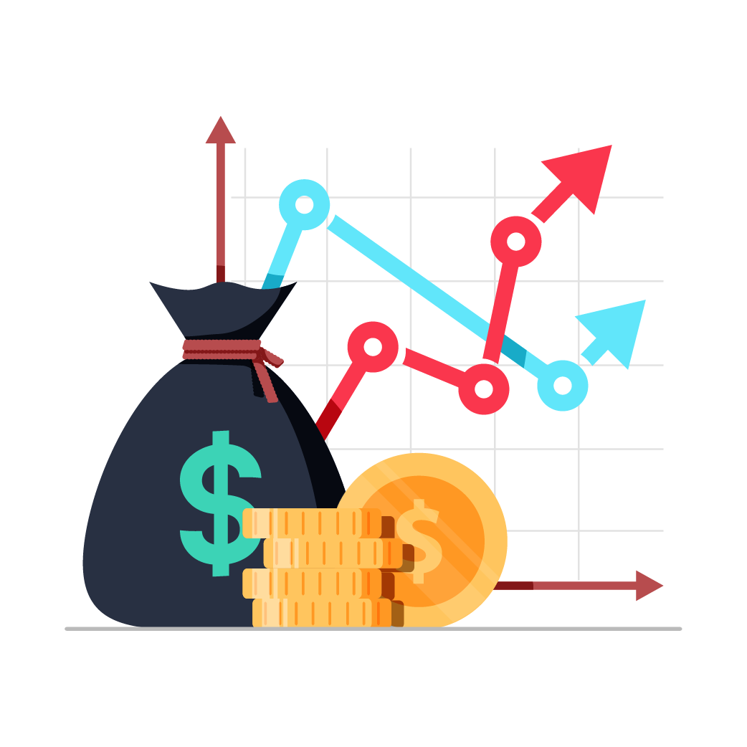
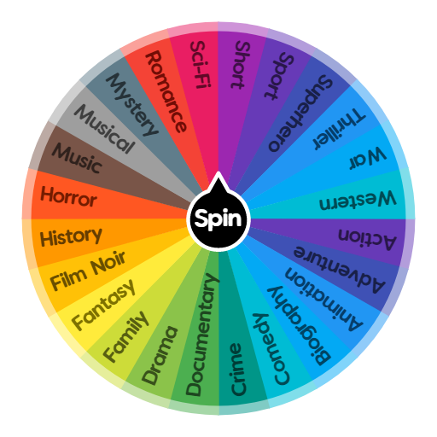

Data sources we used
What Information are available in the datasets?
Revenue data- Movies, Merchandise and Park
Movie Genres
Ratings and how many users rated

Slide 11
Questions the team hopes to answer with the data
How can we utilize users watch history data to help out other companies with product placement?
Can we accurately predict user preferences and help companies market more effectively? Why or why not?

Slide 12
Description of the data exploration phase of the project
We gathered all necessary datasets from websites like kaggle
We looked at the dataset and made sure it provides relevant data for our project
We made sure to go with datasets that do not have a lot of noise and also contains information for a large number of years.

Slide 13
Description of the analysis phase of the project
Once we found our datasets we performed EDA on it
We analyzed the dataset and decided what information we needed and extracted them.
Once we had our desired dataframes using Pandas, we created relevant visualizations.

Slide 14
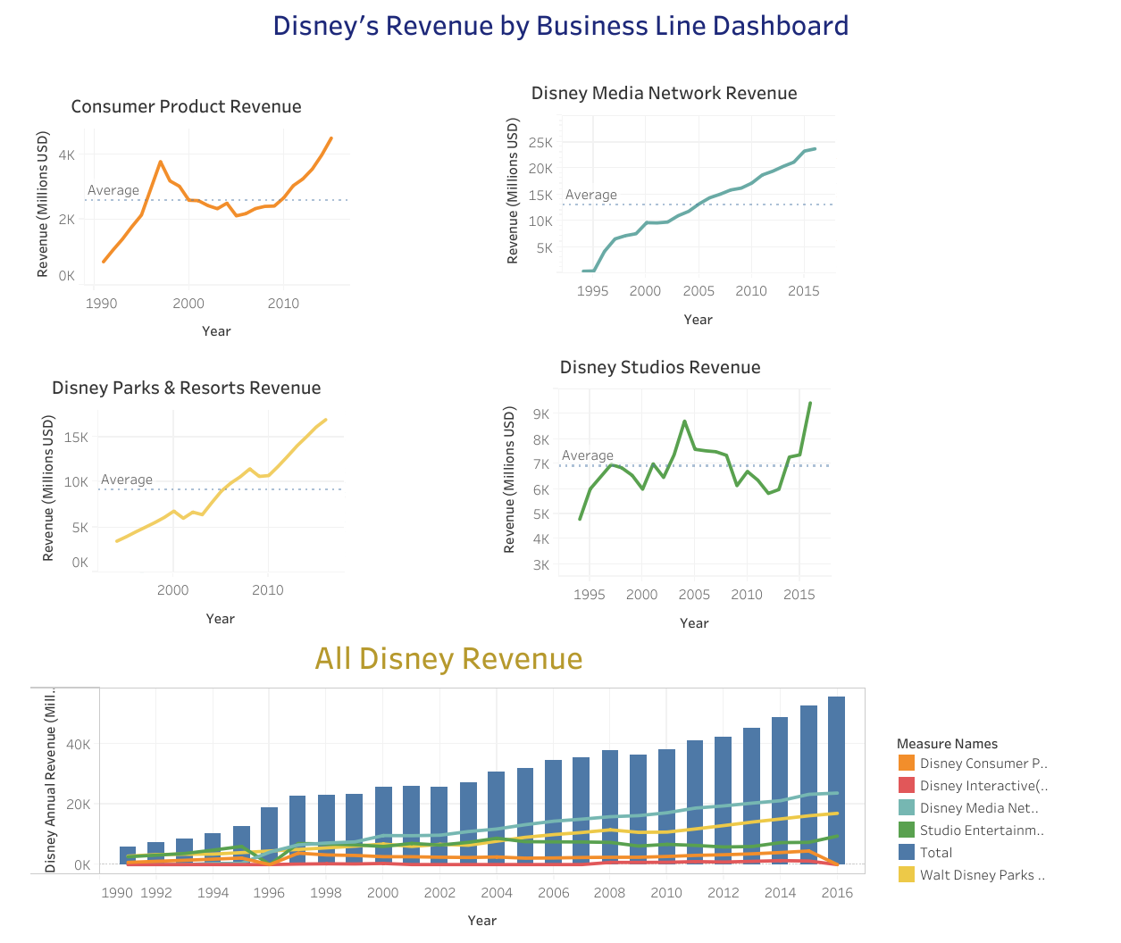

Slide 15
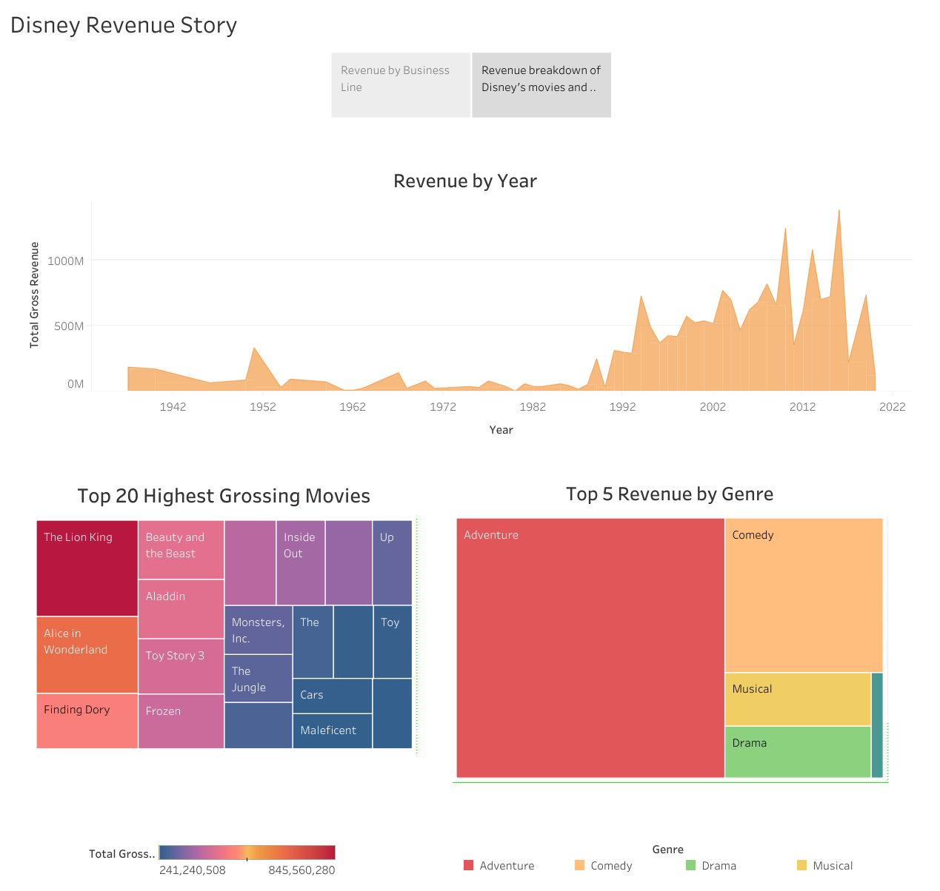

Slide 16
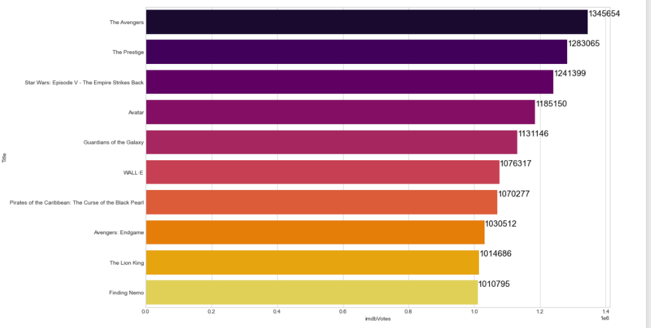
Top 10 movies with highest number of voters

